Slide 1
Bayesian/MCMC Workshop
Session 1: Introduction to Bayes Theorem and MCMC
Henry Ngo
8 Feb 2019

Slide 2
Bayes Theorem (Board)
Notes:
On board: Bayes Theorem

Slide 3
When to be “Bayesian”
= When you can make use of the “prior” term
https://xkcd.com/1132/

Slide 4
When to be “Bayesian” examples
Example Astronomical Scenario | A Bayesian Approach
Distribution and correlation of probability. You have a dataset to measure stellar mass and stellar metallicity and you want to find what the likely values are and how these two parameters may correlate with each other. | Map out the entire posterior space by calculating posterior for many values of the two parameters values, not just “fit” for the best mass.
Using related information in parameter estimation. You are making an independent measurement of stellar mass, but want to include other measurements from literature. | Use prior probabilities for model parameters that reflect knowledge from the literature.
Avoid overfitting. You have a model with a lot of tunable parameter and you want to only use these parameters if necessary. | Use prior probabilities for model parameters that favour values that don’t make a difference to the model (e.g. zero)
Avoid or limit arbitrary decisions. You want to avoid having results skewed by how you classify objects or where you set the bin edges for histograms. | Create a new parameter that indicates which sub-group each data point belongs to. Use priors initially “set” the membership but allow this parameter to evolve with your analysis.

Slide 5
Coin flip and priors example (board)

Slide 6
Jupyter Notebook 1-2

Slide 7
Computing likelihoods (board)

Slide 8
Jupyter Notebook 3-5

Slide 9
Analytical solution (board)

Slide 10
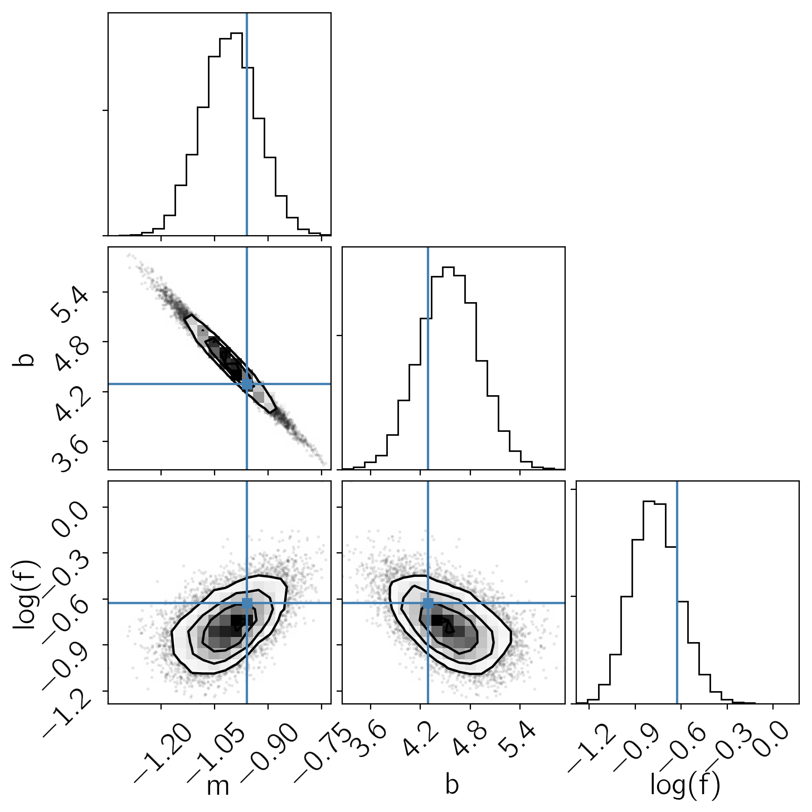
MCMC is not just about best fit
https://emcee.readthedocs.io
“Corner plot” (scatterplot matrix, pairs plot, etc.) showing 1-D marginalized posterior distribution and 2-D joint posteriors for each pair of parameter
This plot shows a line fit with slope m, intercept b, and an extra parameter f describing the noise

Slide 11
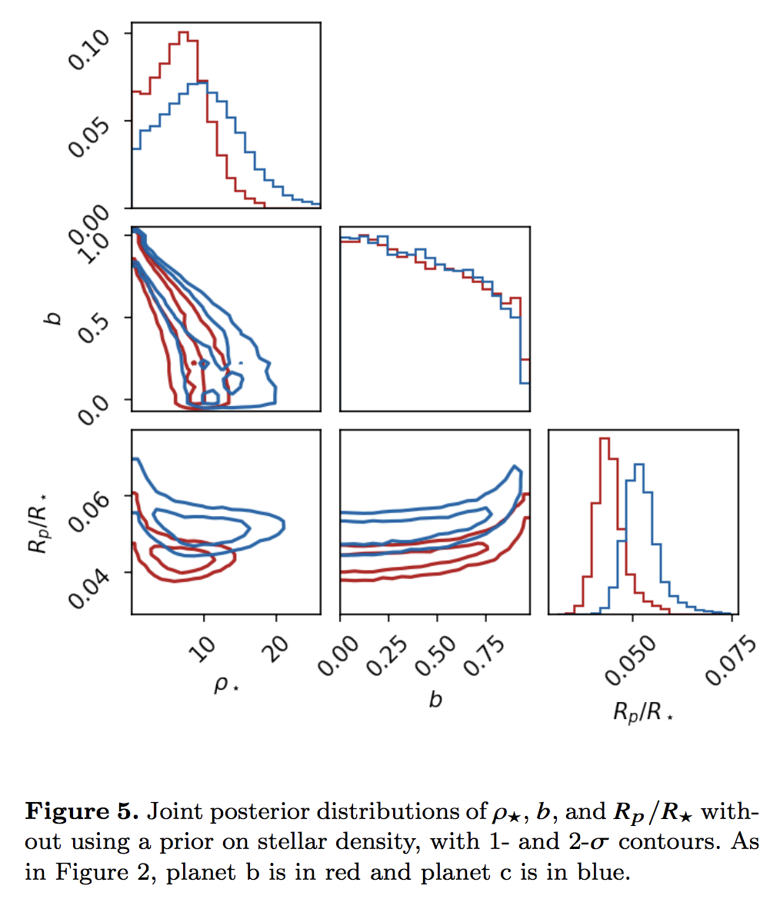
Examples of MCMC in recent papers
Livingston et al (2019), MNRAS
Modelled transiting planet light curve (K2 data). Plot shows posteriors on impact parameter, stellar density and transit depth for the two planets in this system

Slide 12
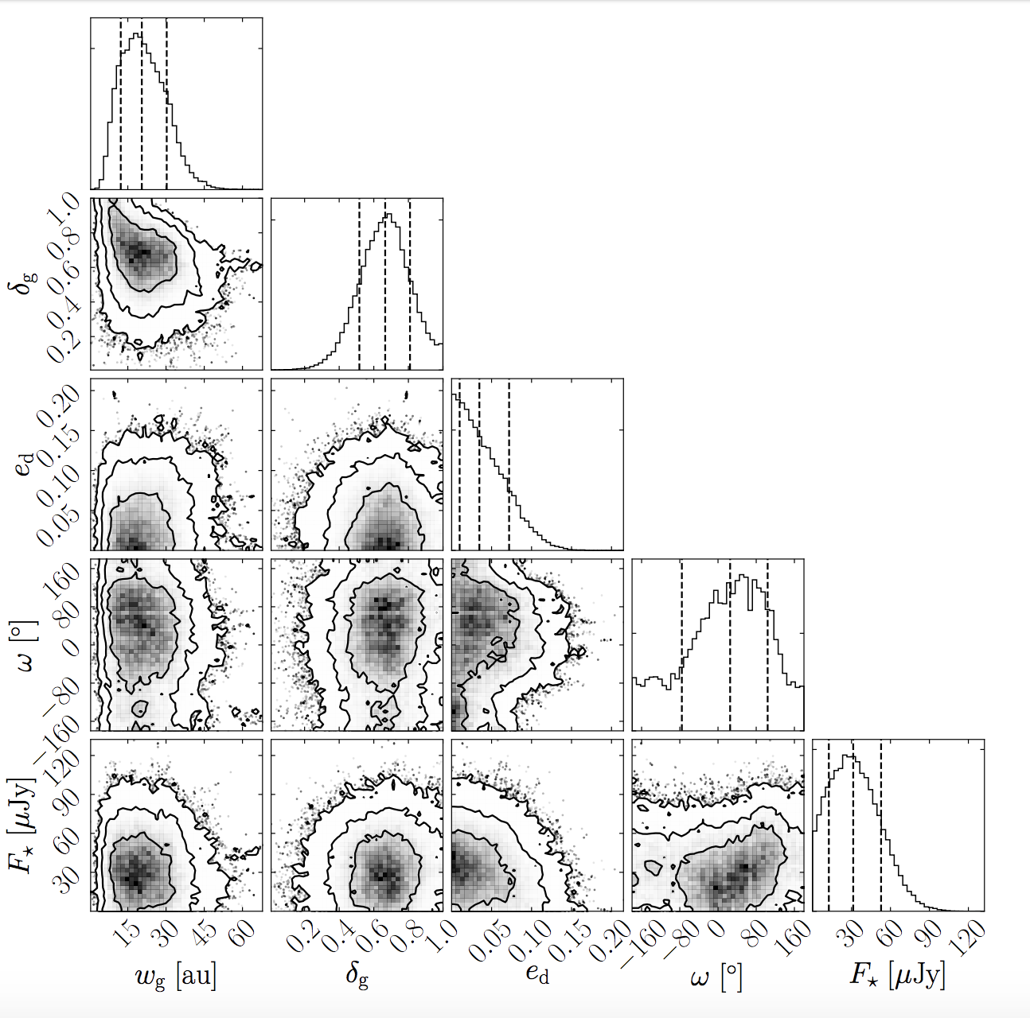
Examples of MCMC in recent papers
Marino et al (2019), MNRAS
Model of a gap in the planetestimal disk of HD 92945 using ALMA data
Notes:
FWHM of gap, fractional depth of gap, disc eccentricity, arg peri of disk? Stellar flux

Slide 13
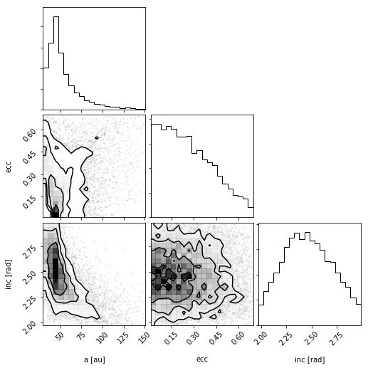
Orbit fitting example
From orbitize! tutorial using data of imaged companion to GJ 504
Notes:
FWHM of gap, fractional depth of gap, disc eccentricity, arg peri of disk? Stellar flux

Slide 14
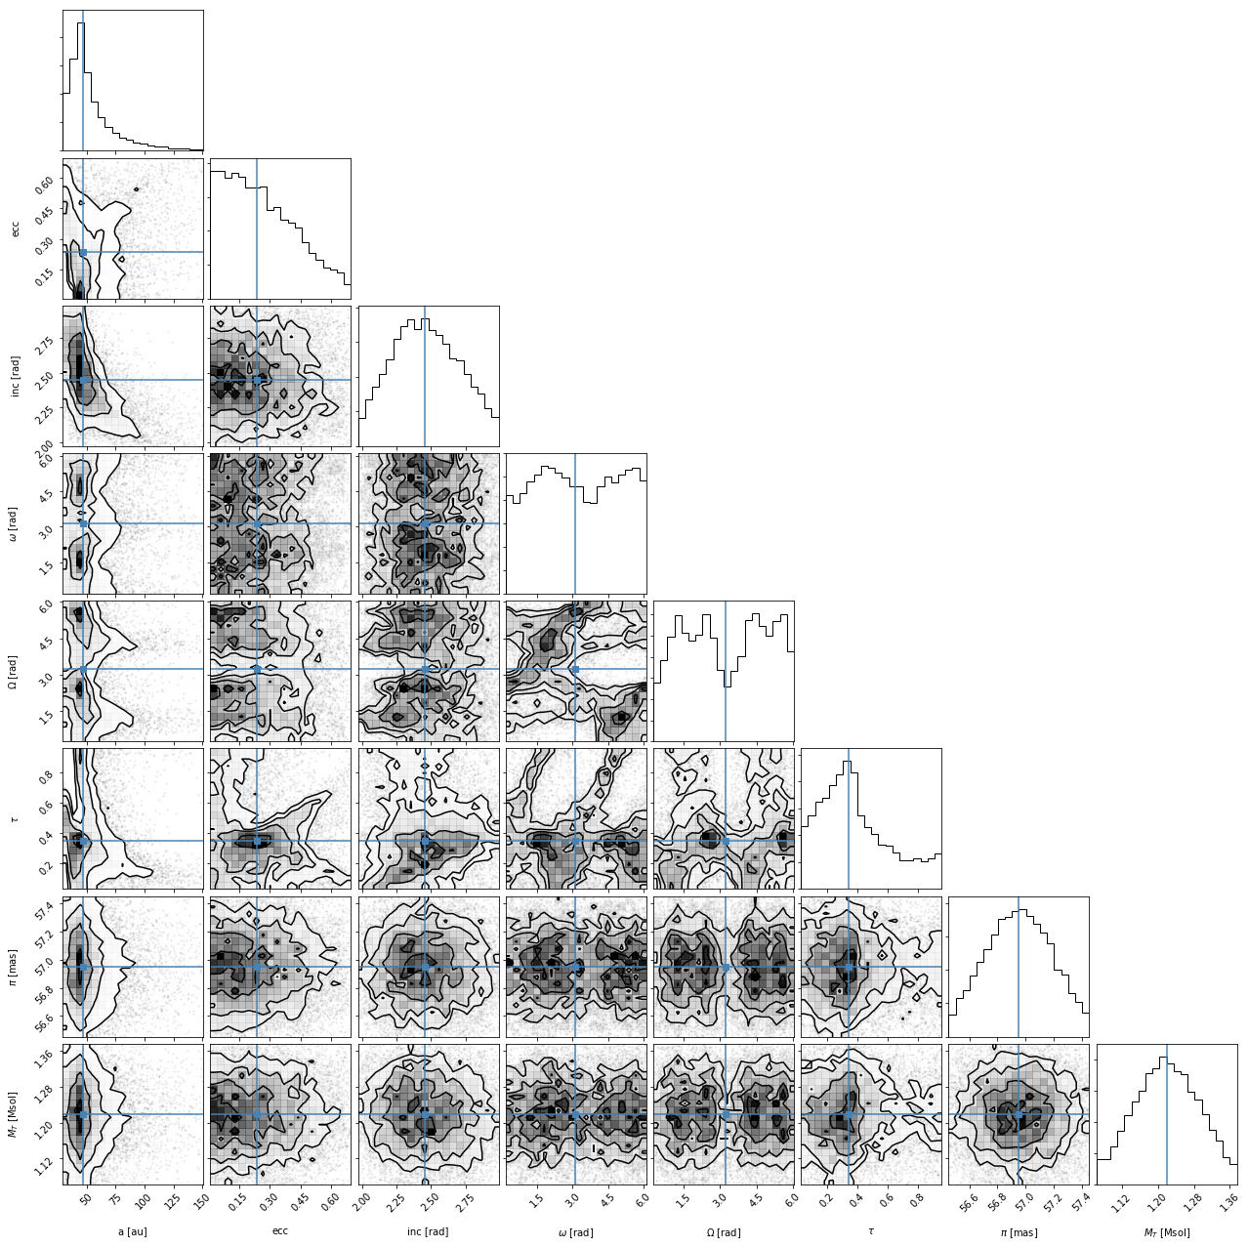
Orbit fitting example
From orbitize! tutorial using data of imaged companion to GJ 504
Notes:
FWHM of gap, fractional depth of gap, disc eccentricity, arg peri of disk? Stellar flux

Slide 15
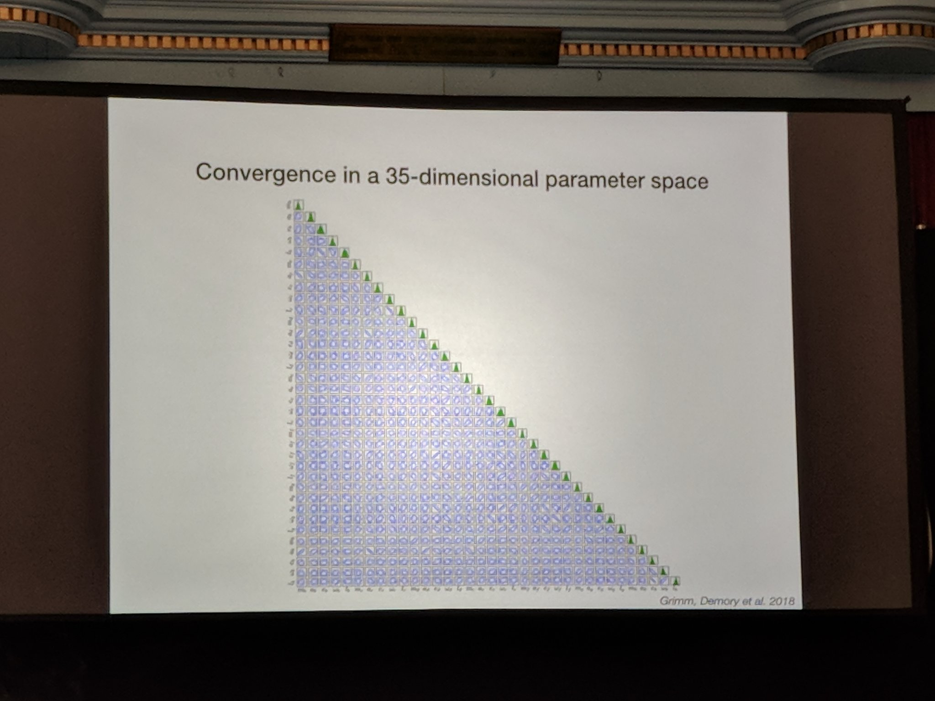
Tweeted by Jason Wang (@semaphore_P) from Exoplanets 2 meeting
Notes:
FWHM of gap, fractional depth of gap, disc eccentricity, arg peri of disk? Stellar flux

Slide 16
MCMC Algorithm (board)

Slide 17
Jupyter Notebook 6-7

